Slide 1
ETC Programmer Workshop 3
Game Events
By Terri Lim

Slide 2
Pre-requisites
You should already be somewhat familiar with Unity.
You should understand what are C# delegates, or at least the concept of function pointers.
If you don’t, watch this video first.
Slides & Unity examples can be found here.
https://github.com/TypeDefinition/ETC-Programmer-Workshops

Slide 3
Quick & dirty: What are events?
Events allows objects to communicate via “messages” rather than having to hold a direct reference to each other.
Reduces coupling and dependencies between objects.
Improves code organisation for projects where many objects depend on one another.

Slide 4

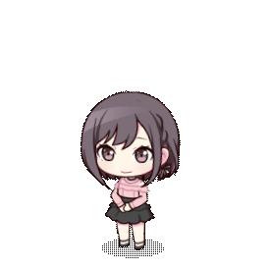


Analogy: Going out to lunch.
Mizuki wants to invite her close friends to lunch.
She can send a direct message to each of them.
This is fine because she knows each of them personally, and there are only a few of them.
Mizuki

Slide 5




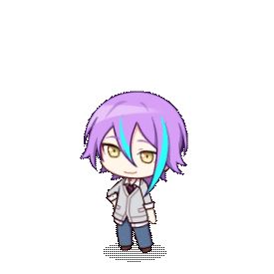

Analogy: Advertising a school festival
Mizuki’s school is hosting a festival and she would like to advertise it to the public.
She cannot directly message everybody in the world, because she doesn’t have everyone’s contact.
Wouldn’t it be nice if she could make a post on social media with a #hashtag so that anyone who’s interested could see it?

Slide 6

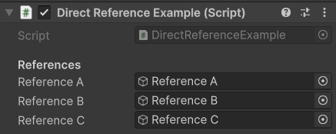
Unity: Direct reference
Similarly in Unity, direct references are fine when you’re only dealing with a small fixed number of objects.

Slide 7
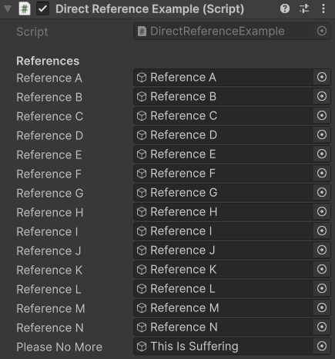

Unity: Direct reference
However, they can quickly get out of hand when there’s too many objects.

Slide 8
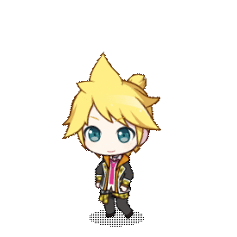
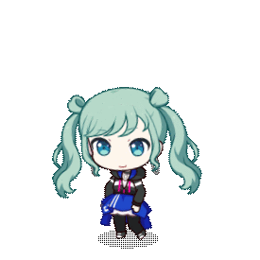
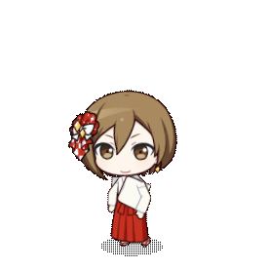
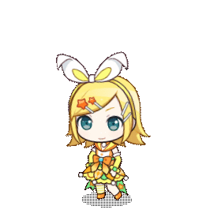
What if we allowed objects to subscribe to messages of a certain type, without needing to know the sender?
We want to see cat photos! #cat
We want to see pictures of food! #food

Slide 9

And we could allow objects to broadcast messages of a certain type, without knowing the receivers?
Look at this cute cat!
#cat

Slide 10

And we could allow objects to broadcast messages of a certain type, without knowing the receivers?
Here’s a photo of my lunch!
#food

Slide 11
And the subscribers would receive those messages.
That kitty is so adorable!
#cat!
That set meal looks delicious!
#food!

Slide 12
Anatomy of an event call.
GameEventSystem.GetInstance().SubscribeToEvent<ArgumentType>(“EventName”, OnEvent);
GameEventSystem.GetInstance() → The event system.
SubscribeToEvent<ArgumentType>(“EventName”, OnEvent) → Listen for events with the name EventName.
SubscribeToEvent<ArgumentType>(“EventName”, OnEvent) → When the event is triggered, the OnEvent callback will be invoked, and an argument of type ArgumentType will be passed in.

Slide 13
Anatomy of an event call.
GameEventSystem.GetInstance().UnsubscribeFromEvent<ArgumentType>(“EventName”, OnEvent);
Stop listening for the event that we previously subscribed to.

Slide 14
Anatomy of an event call.
GameEventSystem.GetInstance().TriggerEvent<ArgumentType>(“EventName”, new ArgumentType());
GameEventSystem.GetInstance() → The event system.
TriggerEvent<ArgumentType>(“EventName”, new ArgumentType()) → Trigger the event with the name EventName for all listeners.
TriggerEvent<ArgumentType>(“EventName”, new ArgumentType()) → Pass in an argument of type ArgumentType when triggering the event.

Slide 15
Design Overview
Game Event System
SubscribeToEvent(“Cat”, OnCatEvent);
SubscribeToEvent(“Food”, OnFoodEvent);

Slide 16
Design Overview
TriggerEvent(“Cat”);
Game Event System
OnCatEvent();

Slide 17
Design Overview
TriggerEvent(“Food”);
Game Event System
OnFoodEvent();

Slide 18

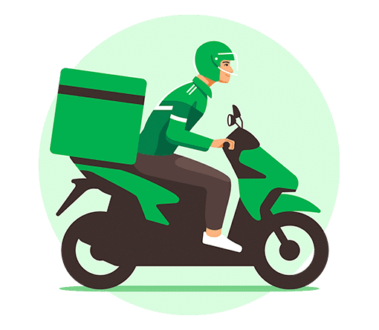

A more complex example: Food Delivery App
Let’s simulate a food delivery app.
Customer
Shop
Deliveryman

Slide 19
Customer creates an order
A small pizza please!
I accept your order.
Customer

Slide 20
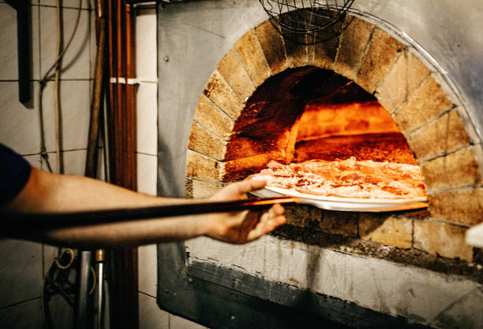
Shop cooks pizza

Slide 21

Shop creates delivery requests
Pizza is ready!
I need a deliveryman.
I accept your order!
Aww, we’re too slow!

Slide 22
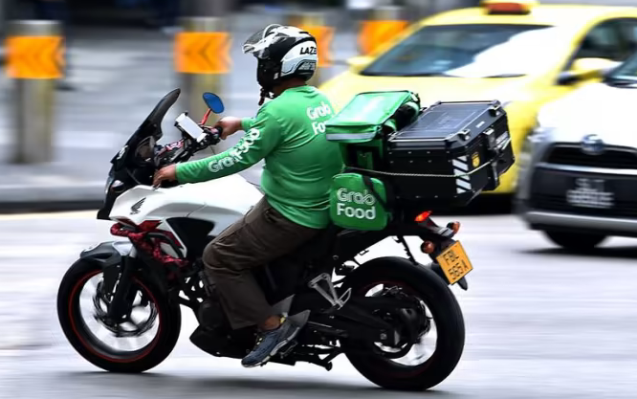
Deliveryman travels to shop

Slide 23
Deliveryman picks up food
I have arrived at the shop. I’m picking up the order.
Okay.

Slide 24
Deliveryman travels to customer

Slide 25
Deliveryman completes delivery
Hello customer, your pizza has arrived.
Thanks! Time to eat!

Slide 26
Live demo time!
Let’s learn how to use such a system in Unity.

Slide 27
Summary: Must-know functions
SubscribeToEvent()
UnsubscribeFromEvent()
TriggerEvent()

Slide 28




Fin.
Any questions? Ask away!

